Slide 1
Checkers
Developed By..
Vinnie Da Silva
Pratima L. Gauns

Slide 2
Concept
While playing a real time board game , if suddenly you are called by an urgent work. You’ll have to leave the game in the middle and run away.
What if you could transfer the game’s state to a device and resume the play on the device after some time.
That’s the concept we tried demonstrating through our app using a Checker game.

Slide 3
Screens
Screen 1- Image Capture Screen
Allows you to capture an image. Adjust the iPad camera to correctly fit the displayed frame with your game board.
We detect the board edges and show the preview of the captured image. User can either select the image and go to Next or recapture.
The “Select Demo Picture” allows to select a static picture for demo purpose in case game board is not there.

Slide 4
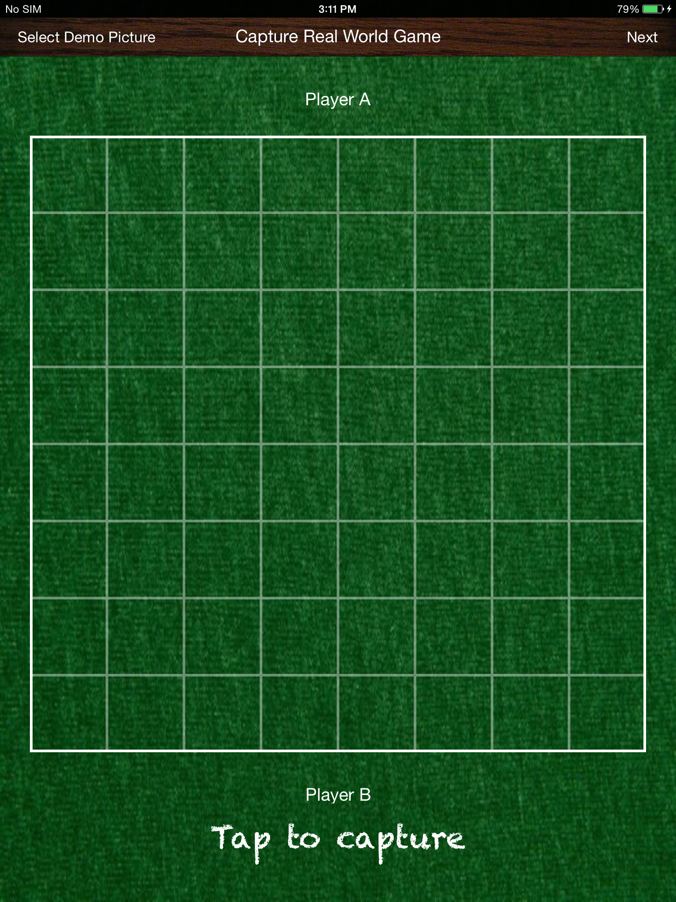

Slide 5
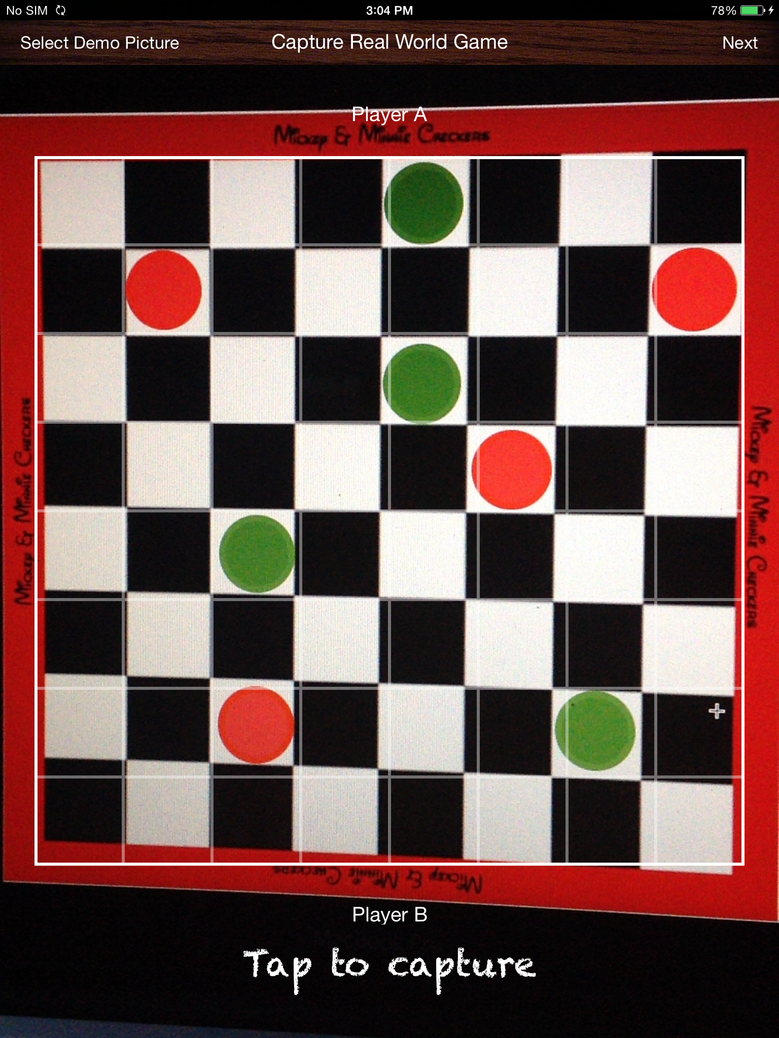

Slide 6
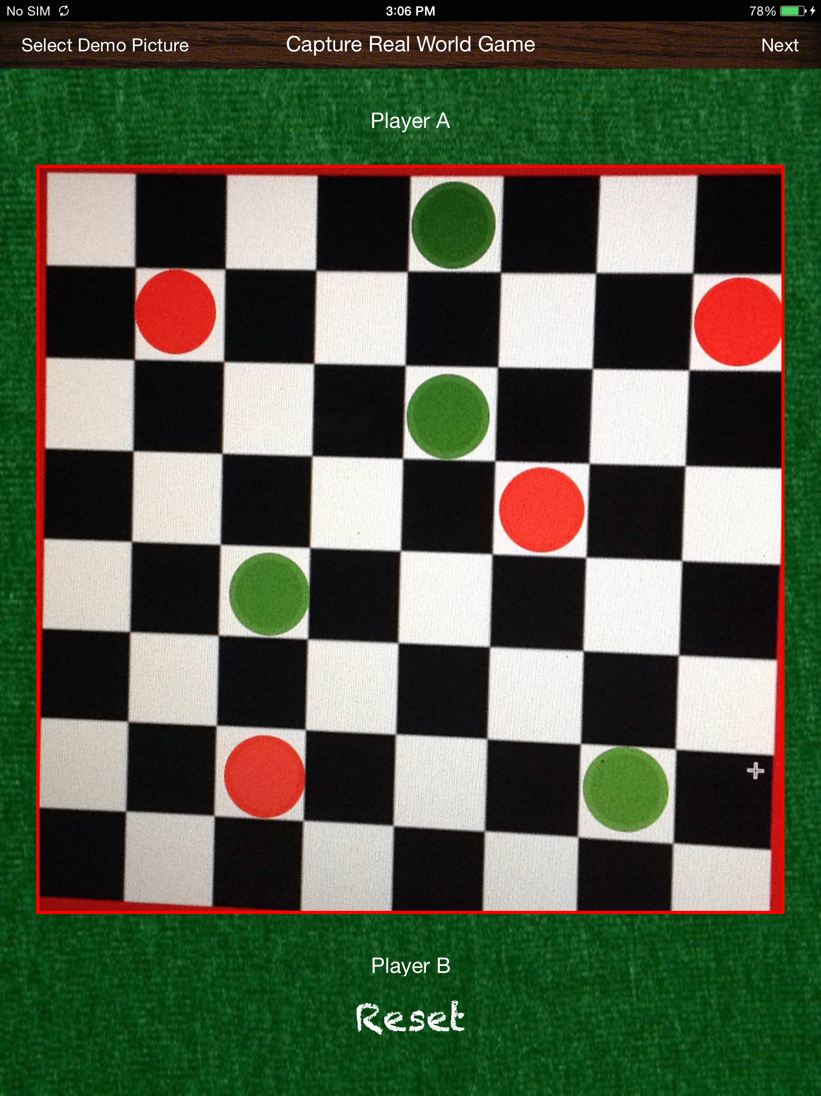

Slide 7
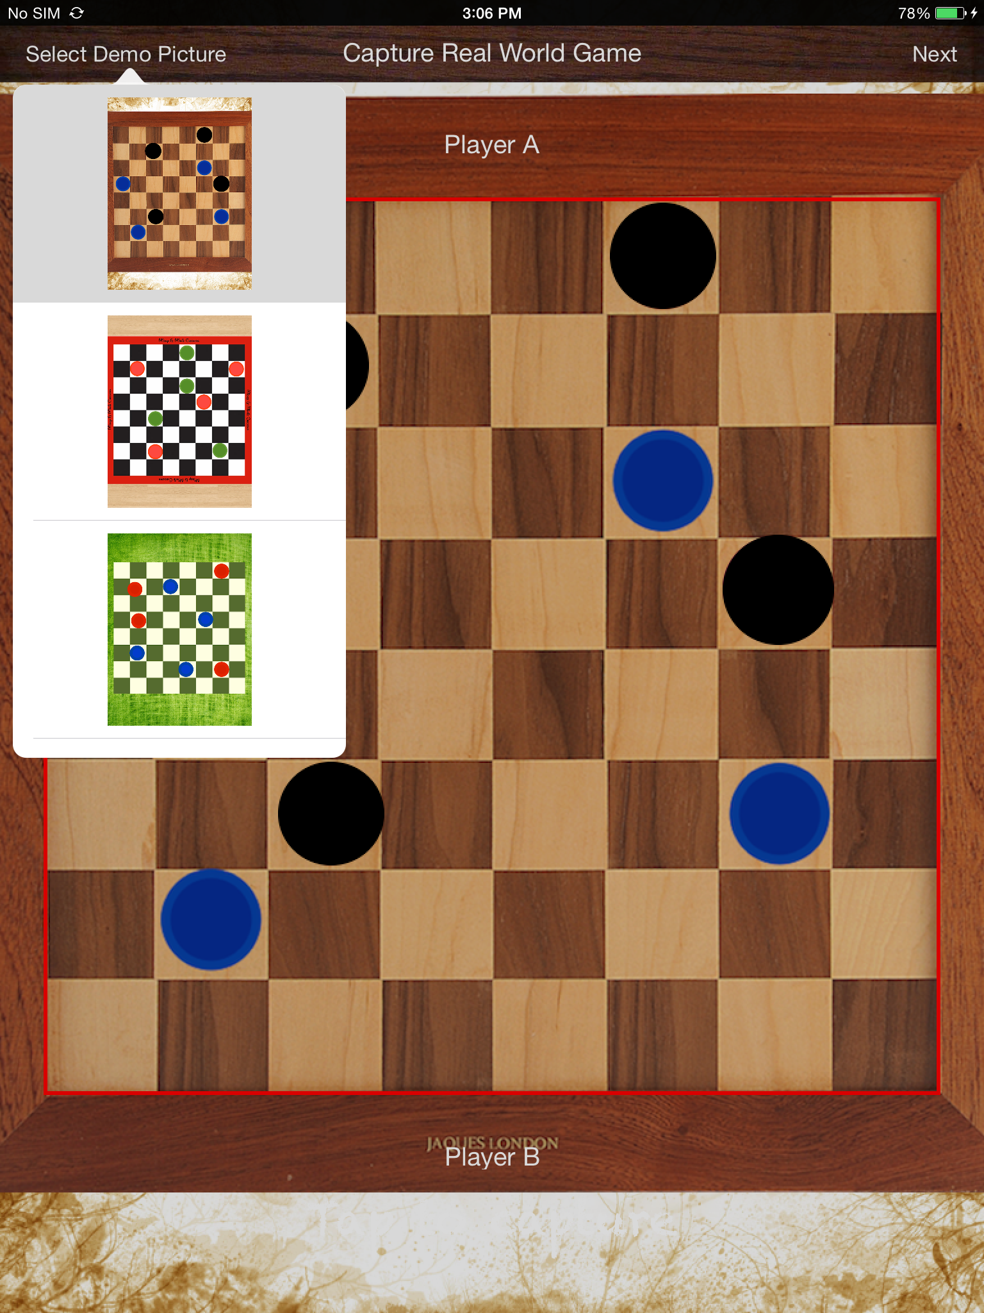

Slide 8
Screens
Screen 2 – Game Screen
The captured image is passed to this screen and the board is drawn.
We detect the coins within each check and draw them with the actual color.
The coins can be moved across to proceed with game play.

Slide 9
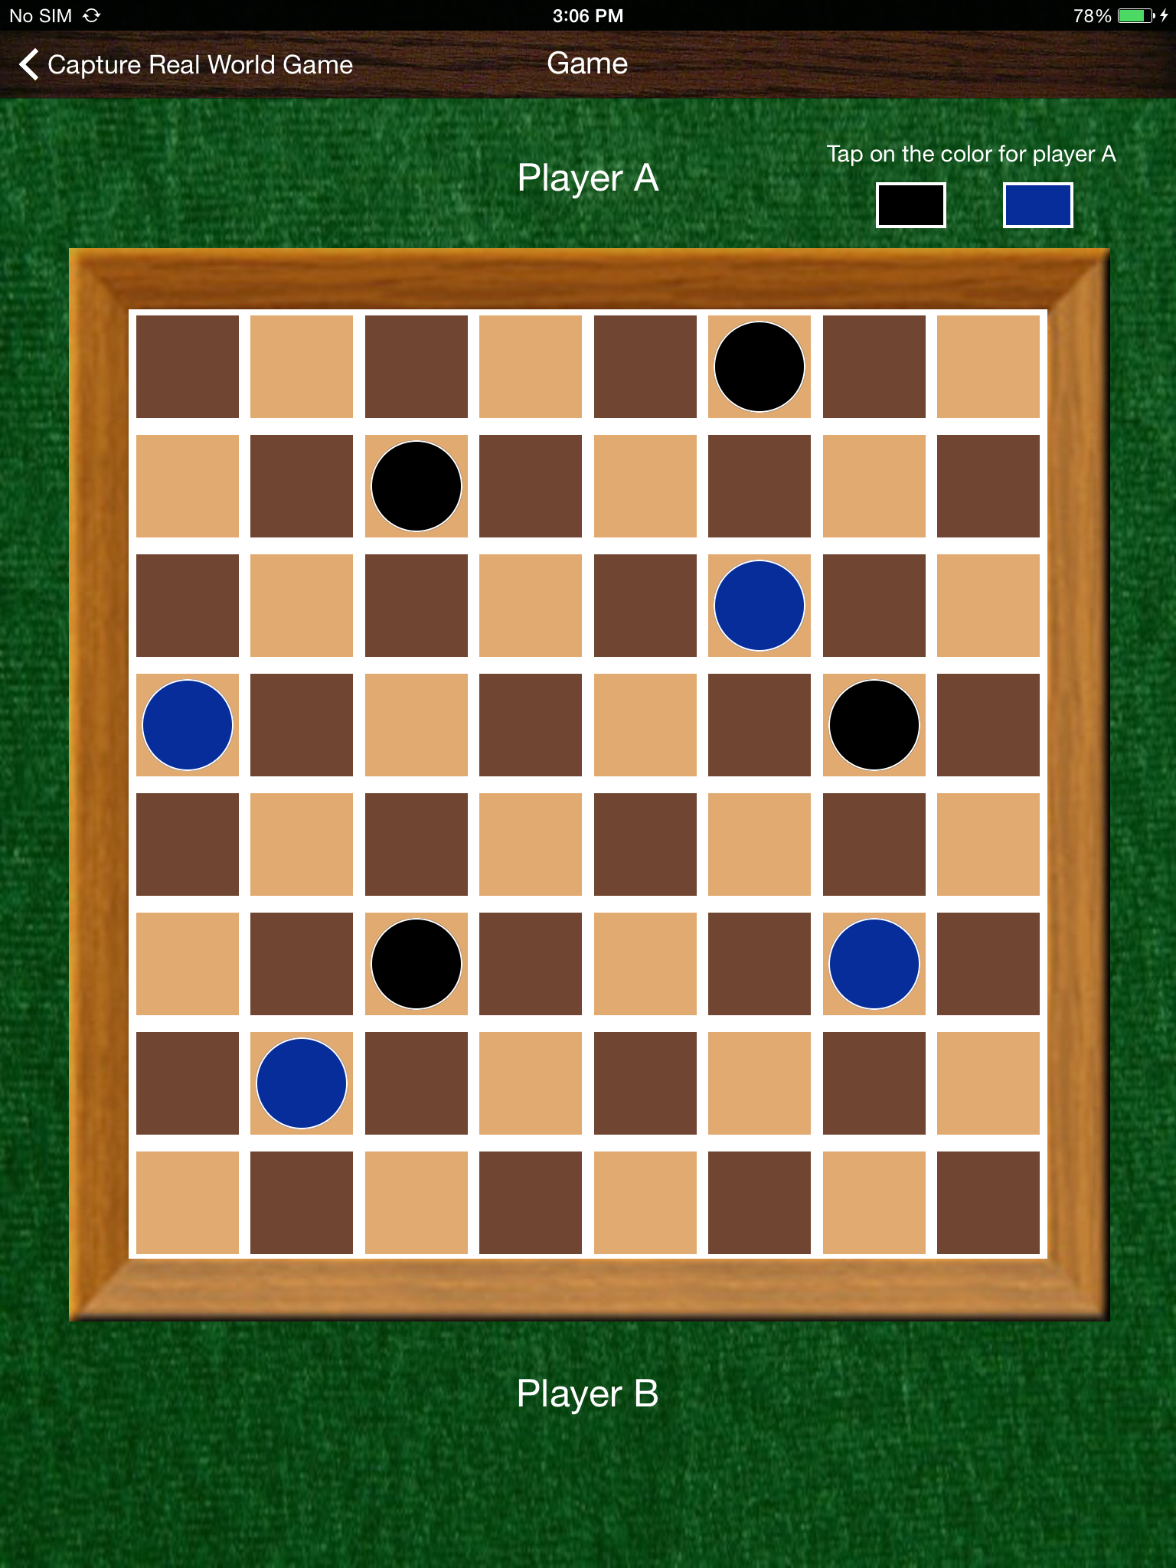

Slide 10
